Slide 1
Pneumonia Detection Using Chest X-Rays
Instructor: Dr. Chaojie (Jay) Wang
Author: Raheem Shaik

Slide 2
Problem Statement
Pneumonia is one of the leading causes of hospitalization and mortality.
Chest X-ray interpretation is:
Time-consuming
Requires expert radiologists
Subjective, sometimes inconsistent
Goal:
Build a deep learning model that automatically classifies X-ray images into:
Normal
Pneumonia

Slide 3
Why This Matters
Impact of the Project
✔ Faster preliminary screening in hospitals
✔ Reduces radiologist workload
✔ Helps regions with limited medical expertise
✔ Shows how AI can support real medical decisions

Slide 4
Architecture & Tools
Architecture Flow
Dataset → Preprocessing → CNN Model → Evaluation → Web App Deployment (Streamlit)
Technologies Used
Programming: Python, NumPy, Pandas
Modeling: TensorFlow/Keras, CNN
Visualization: Matplotlib, Seaborn
Deployment: Streamlit
Environment: Google Colab (GPU)

Slide 5
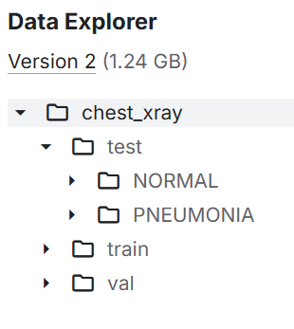
Data Overview
Dataset: Kaggle Chest X-Ray Pneumonia
~5,863 pediatric chest X-rays
Two classes: NORMAL, PNEUMONIA
Pre-labeled by radiologists
Split into train/validation/test

Slide 6
Data Dictionary
Column Name | Type | Description
image_id | String | File name
label | Binary | 0 = Normal, 1 = Pneumonia
pixel_data | Image | Chest X-ray pixels

Slide 7
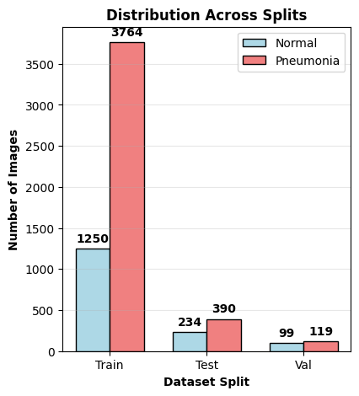
Class Distribution

Slide 8
Methodology
Steps:
1️⃣ Load and explore dataset
2️⃣ Preprocessing
3️⃣ Build Baseline CNN
4️⃣ Train/Test split
5️⃣ Hyperparameter tuning
6️⃣ Evaluate
7️⃣ Build app for prediction

Slide 9
Model Architecture
Baseline CNN:
Conv2D → ReLU
MaxPooling
Conv2D → ReLU
MaxPooling
Flatten
Dense (ReLU)
Dropout
Output (Sigmoid)
Training
Loss: Binary cross-entropy
Optimizer: Adam
Epochs: 10

Slide 10
Model Evaluation
Class | Precision | Recall | F1-Score | Support
NORMAL | 0.72 | 0.99 | 0.83 | 135
PNEUMONIA | 0.99 | 0.87 | 0.93 | 388
Accuracy | — | — | 0.90 | 523
Macro Avg | 0.86 | 0.93 | 0.88 | 523
Weighted Avg | 0.92 | 0.90 | 0.90 | 523

Slide 11
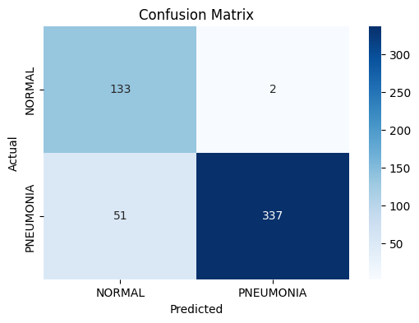
Confusion Matrix

Slide 12
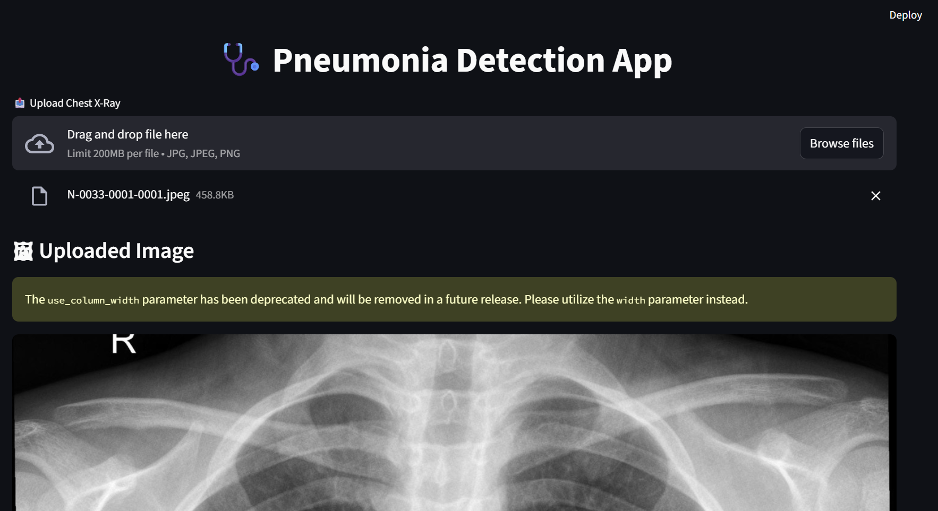

Model Demo

Slide 13
Limitations
Pediatric-only dataset
No multi-disease classification (only pneumonia)
Small validation set
No clinical context included (age, symptoms)

Slide 14
Conclusions & Future Work
Future Work
Use larger & adult datasets
Try pretrained models: ResNet, EfficientNet, VGG16
Add Grad-CAM explainability (after fixing model architecture)
Deploy as web API for hospitals
Add multi-class predictions (TB, COVID, etc.)
Conclusion
CNNs can classify pneumonia from X-rays with high accuracy
Deep learning can support radiologists in early diagnosis
Project demonstrates ML workflow end-to-end
Successfully built a functional medical AI app

